Slide 1
Monitoring and Explainability
Introduction to Deep Learning: Class 2.2

Slide 2
Agenda
Experiment Tracking
Monitoring/Observability
Explaining model predictions
Profiling

Slide 3
Experiment Tracking
Every ML experiment goes through:
Define configuration: hyperparameters, model architecture, optimizer type, batch size, dataset version
Train model: Record loss curves, gradients, LR schedule, checkpoints
Evaluate model: Accuracy, F1, ROC-AUC
Compare results: across multiple runs and hyperparameter settings
Version and archive model artifacts, code (git commit hash), data (dataset version), environment (conda/pip env, dependencies)
Reproduce or deploy
Experiment tracking tools automate and persist most of these steps.
We’ll consider three tools: Tensorboard, MLFLow, Weights and Biases

Slide 4
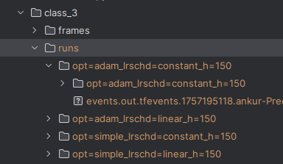
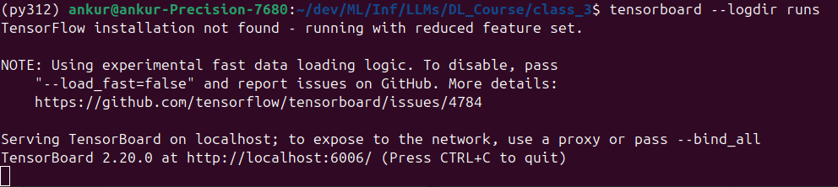
Monitoring using TensorBoard
Primary Use: Visualize training metrics and debugging info
Metrics
Pytorch Program
Logs directory
Can be local or cloud storage
Pip install tensorboard
Tensorboard Server
UI: Can use port forwarding if Tensorboard server running remotely
Can run locally or cloud-hosted
class3/simple_nn1_tb.py

Slide 5
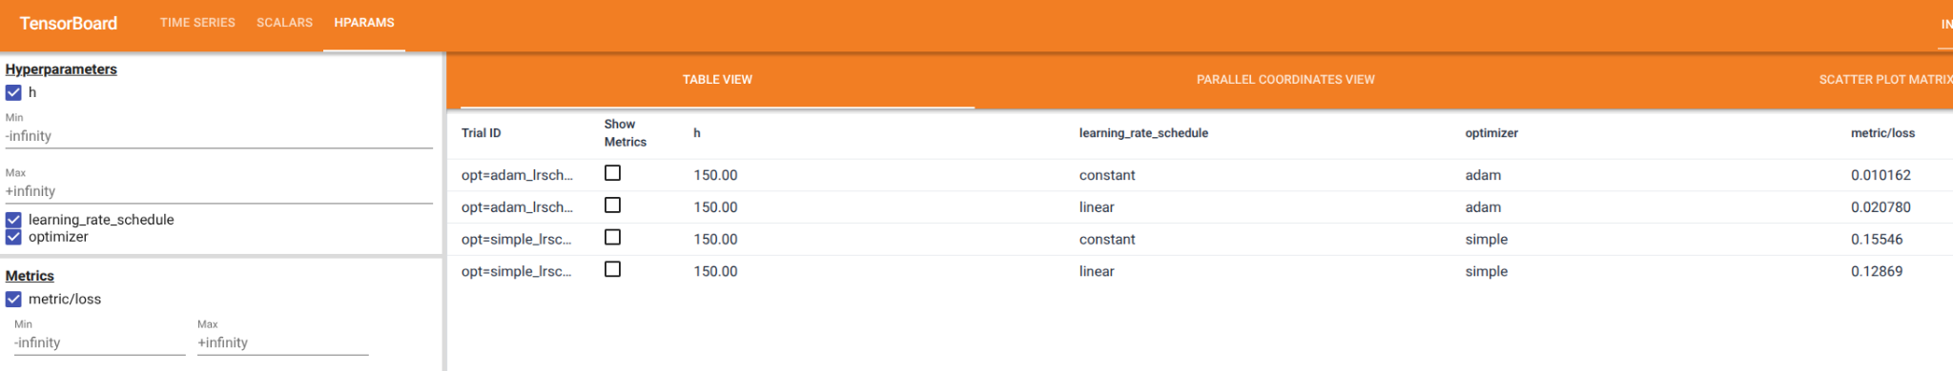
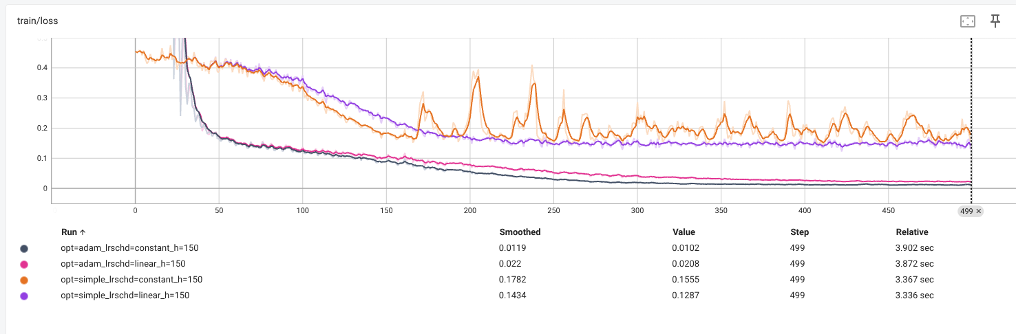
Monitoring using TensorBoard

Slide 6
Monitoring using MLFlow
Primary Use: End-to-end ML lifecycle: track experiments, manage models, deployments
Run MLFlow server with:
backend store: Typically a database such as PostGres, MySQL, or MSSQL. For storing parameters, metrics, and tags
artifact store: local directory or cloud storage such as S3. For large artifacts such as model weights, checkpoints..
Pytorch Program
Artifact location, presigned S3 URLs..
MLFlow Server
Backend store
Metadata
Metadata Params, metrics, tags..
Artifacts
If no mlflow tracking server configured, mlflow client will write metrics to local mlruns directory
Artifact store
class3/simple_nn1_mlflow.py

Slide 7
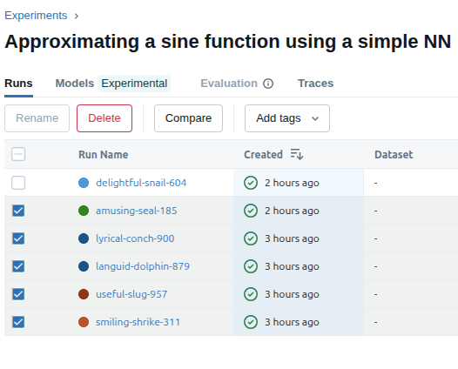
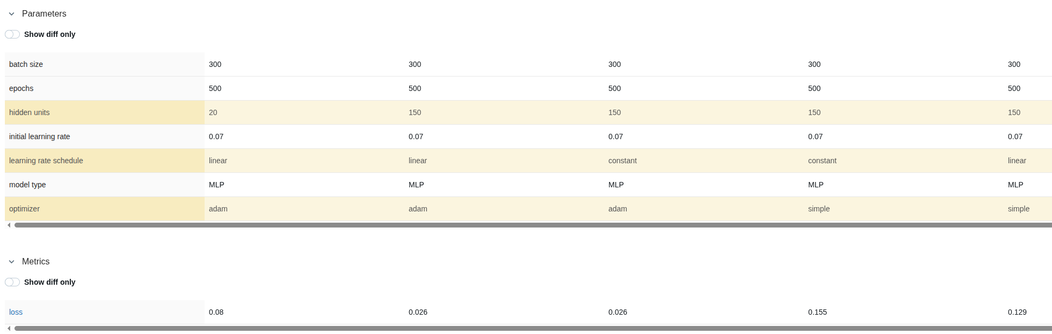
MLFlow: Comparing Runs of an Experiment

Slide 8
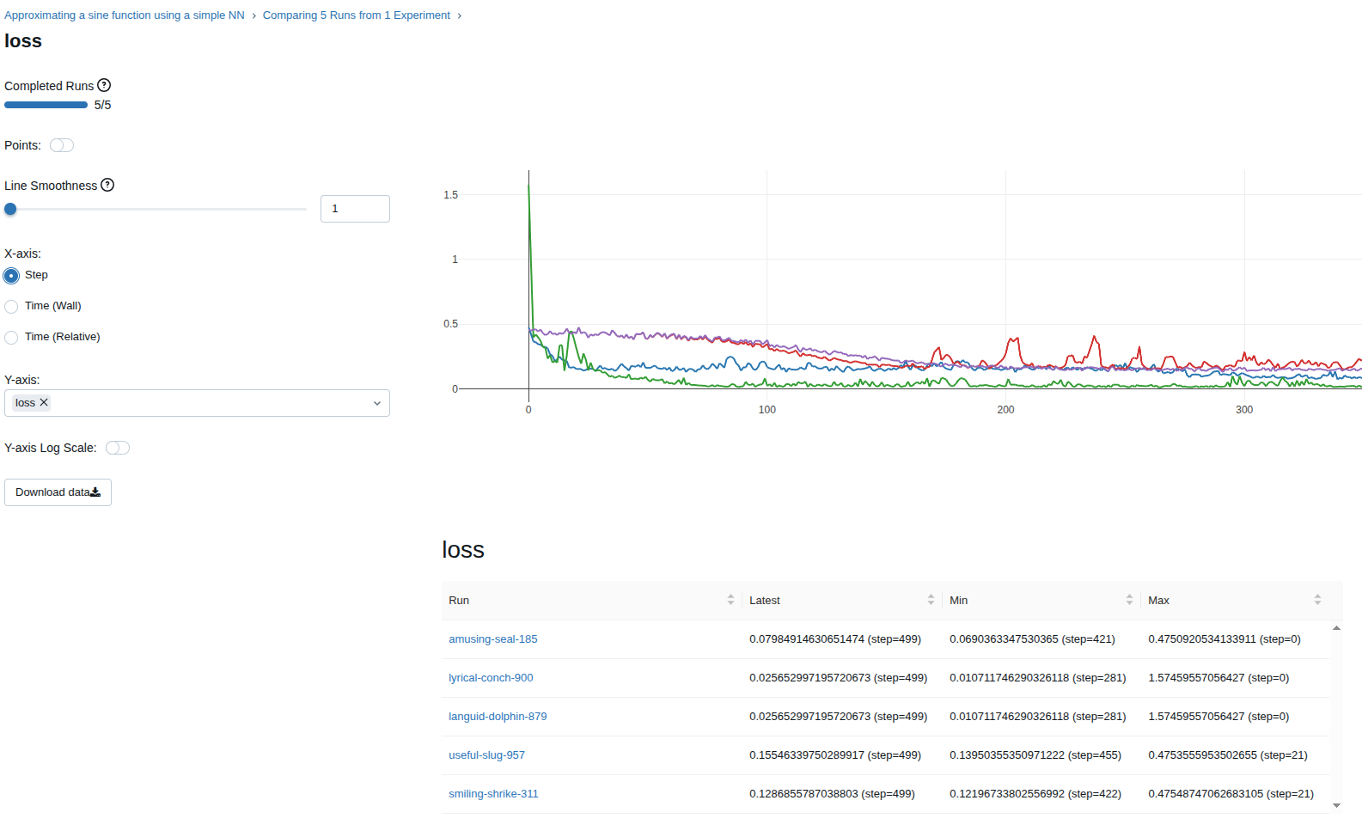
MLFLow

Slide 9
Monitoring/Tracking using Weights and Biases
Area | Weights & Biases (W&B) | MLflow
Core goal | Experiment tracking & collaboration | End-to-end ML lifecycle (track, package, registry, serve)
Hosting | Primarily SaaS (with enterprise self-host/on-prem options) | Open source, easy to self-host (FS/DB/S3/GCS/etc.)
Experiment tracking | Excellent UI/UX, live dashboards, rich comparisons | Solid tracking; simpler UI; highly portable metadata
Hyperparam optimization | Sweeps: first-class HPO with schedulers/search | No native HPO; plug in Optuna/Ray/Tune and log to MLflow
Collaboration | Reports, tables, comments, sharing, org features | Basic comparisons; collaboration mostly via your infra
Cost/lock-in | SaaS convenience; enterprise plans; some lock-in risk via UI features | No license cost; infra cost only; minimal lock-in (files/API)
https://wandb.ai/site/

Slide 10
Monitoring/Observability
ood?
Reference
- Data quality/integrity
- Missing columns, NaNs
- Data type mismatch
- Schema mismatch
Feature importance drift
Eg,, SHAP value distributions
ood?
Reference
Model
(Real-time)
Input data
Aggregation
Kafka->Flink->Storage
Output Distribution Drift detection
Model
(batch)
For model output distribution drift, is the model performing differently for a certain classes?
Also, standard performance monitoring.. p99, time outs, HW utilization, traffic volume..
Accuracy, F1, AUC, RMSE..
Labeling / Groundtruthing
Human/Machine

Slide 11
Metrics to capture Data Distribution Drift
Key idea: We have a metric of interest (eg., model prediction confidence) and we have a “reference” or “expected” distribution for it, calculated from the training dataset. We run the model in production and collect samples of the metric of interest and calculate a distribution based on these samples. Then we calculate various distance metrics between the distributions

Slide 12
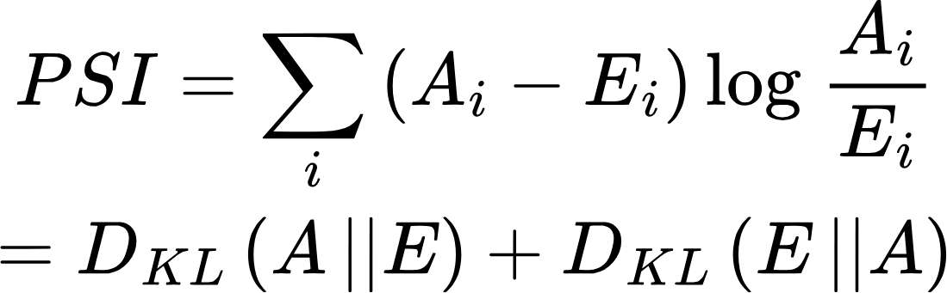
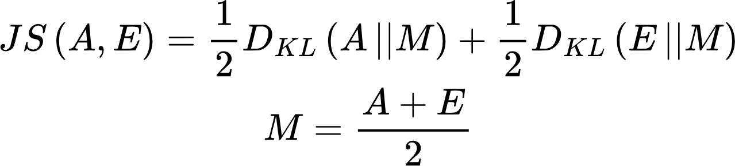
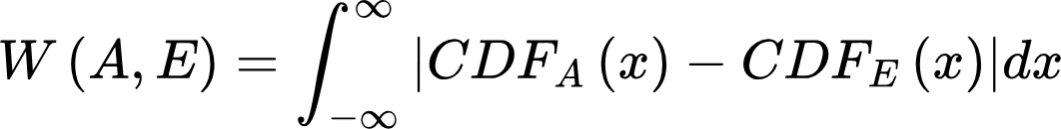
Metrics to capture Data Distribution Drift
Metric | Formula | Bounded? | Core idea | When to use
PSI |  | Unbounded | Symmetric KL, uses decile bin edges, widely used and understood | Categorical variables, bounded numerical features (eg., normalized confidence score, percentages, rates)
Jensen Shannon Divergence (JS) |  | Bounded (0-log(2)) | Smooth KL, compares distributions via midpoint | Categorical variables, bounded numerical features (eg., normalized confidence score)
Wasserstein |  | No, but well behaved | Geometric distance.. How much mass must be moved to transform one distribution to another, Principled metric to measure drift. Can be calculated both from histograms AND samples.. | All of the above + unbounded numerical features--house prices, latency, embeddings norms..

Slide 13
Handling Out of Distribution Data..
What happens if an out-of-distribution value is encountered in production data?
Ignore it (bad)
Shove ood values into edge bins: Drift increases for first/last bins, but lose info about how far OOD the value was
Extend the bins to include ood value: Most principled approach. Reference distribution will have 0 mass in those bins, so distribution based drift metrics will spike appropriately. However, once a value is binned, all values in a bin are equivalent
Wasserstein distance (calculated using samples) handles ood the best. Distance will increase based on how ood the value moved. Detects severity of ood
PSI/JS detect something changed

Slide 14
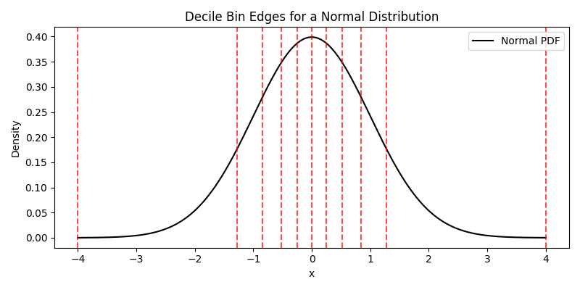
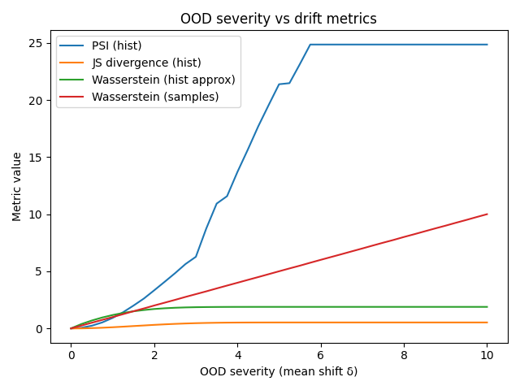
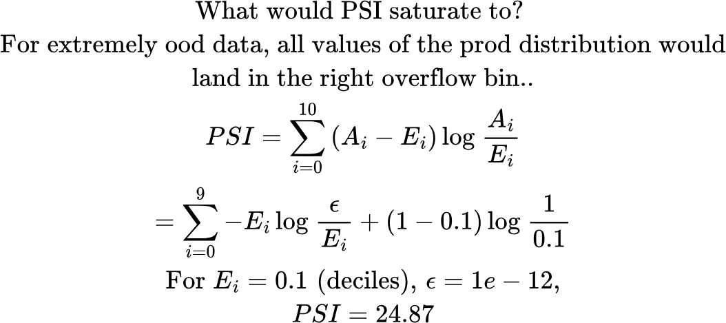
Plotting monitoring metrics against degree of ood

Slide 15
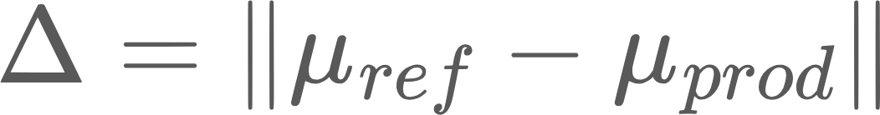
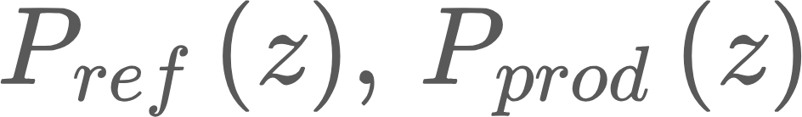
Tracking distribution drifts in embeddings
You could track each component of an embedding vector, but this is suboptimal
Some common methods:
Mean embedding shift
Average pairwise distance
Sliced Wasserstein
Likelihood based methods (per-sample ood): Fit a distribution on the reference embeddings, track log likelihood/Mahalanobis distance
Global vs class-conditional embedding drift
Global
class-conditional

Slide 16
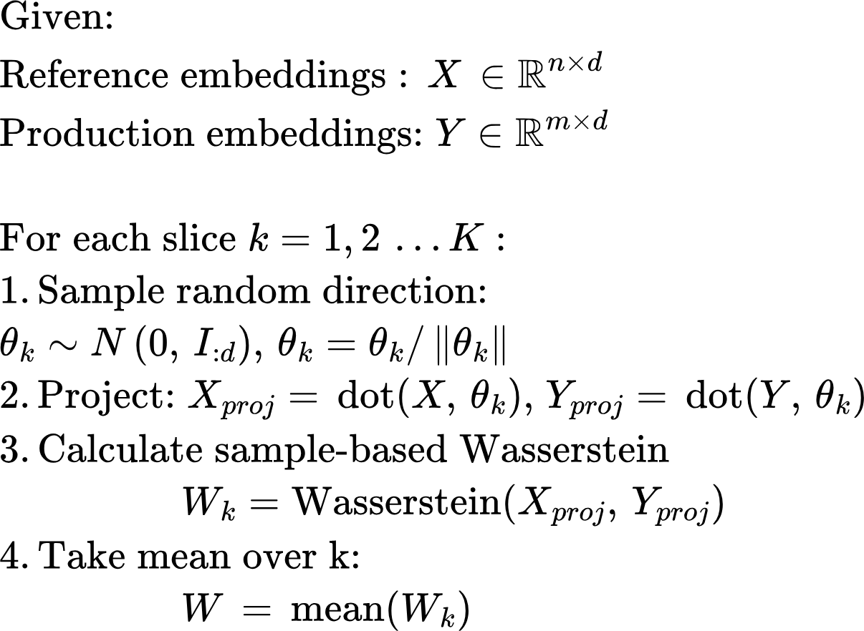
Tracking distribution drifts in embeddings
Sliced Wasserstein:
Taking the dot product in a certain direction is like “looking at the distribution from that direction”
Robust to outliers
Sensitive to severity of ood
Works well in high-dimensions
Computationally tractable
Need a large enough k to capture structure in the embeddings

Slide 17
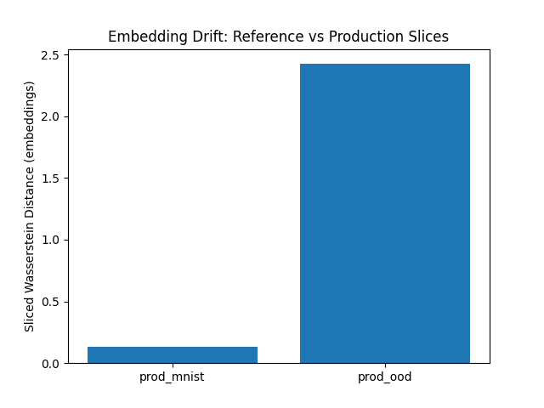
Sliced Wasserstein: MNIST embeddings

Slide 18
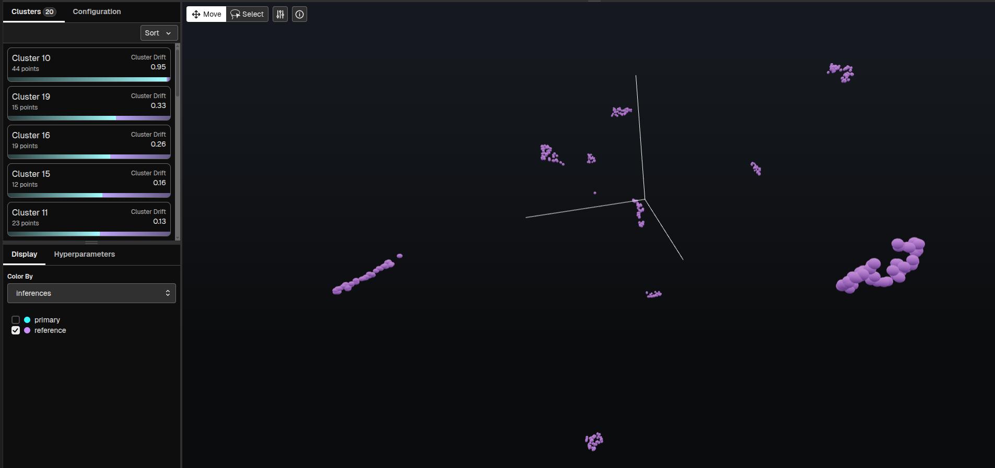
Visualizing embeddings using Arize

Slide 19
Profiling

Slide 20
HW Monitoring Tools
To analyze hardware metrics such as GPU utilization, time taken by various CUDA kernels etc, there are several tools, some HW vendor specific, some offered by deep learning libraries
Pytorch profiler for determining the most expensive operators in the model. The UI is integrated with TensorBoard
NVIDIA Nsight: Detailed GPU-level stats. Great for low-level GPU profiling
Intel VTune: Profiler from Intel
We’ll look at Pytorch profiler and NVIDIA Visual Profiler in detail when we discuss running Neural Networks on GPUs

Slide 21

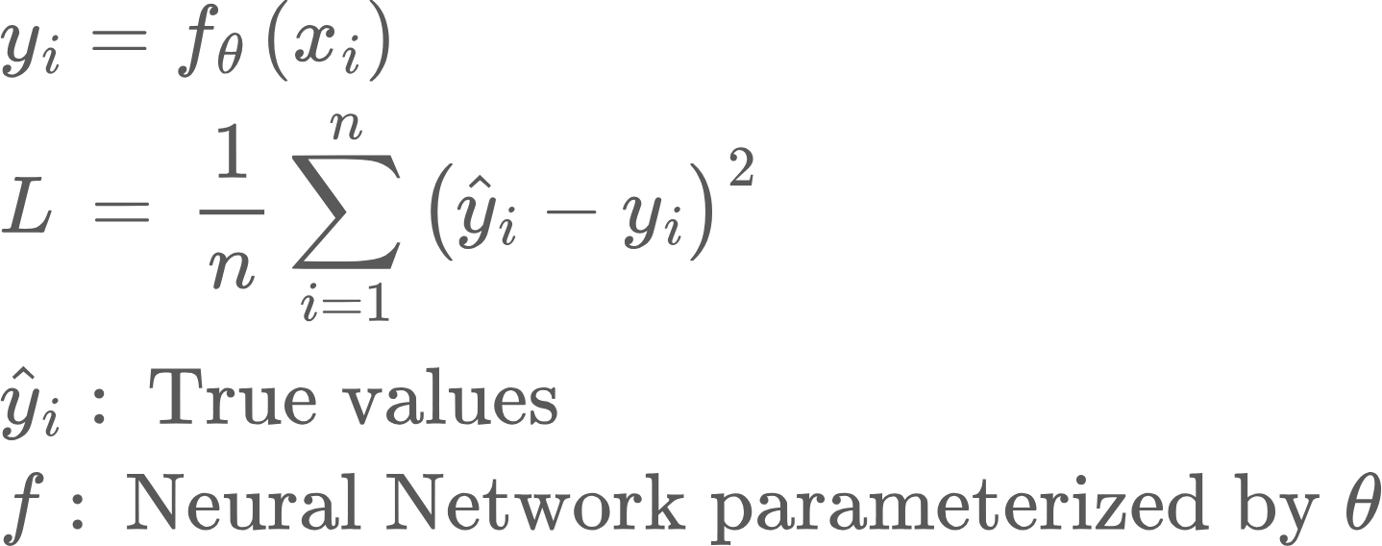

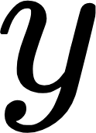


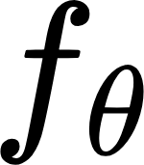
Cross Entropy Loss
In the previous slide, our network produced a real value, which could be compared to the true value using Mean Square Error loss
MatMul + ReLU
MSE Loss
But what if we have a classification problem, where each data point is a class label?
Why can’t we still use MSE loss?
In such as case, the network needs to output the probability distribution over classes, i.e., a vector, where each entry is a probability of a class.

Slide 22
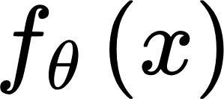
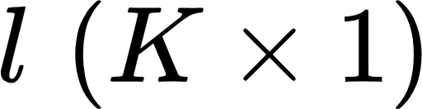
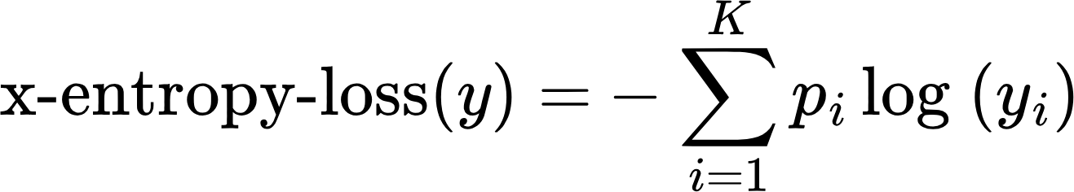
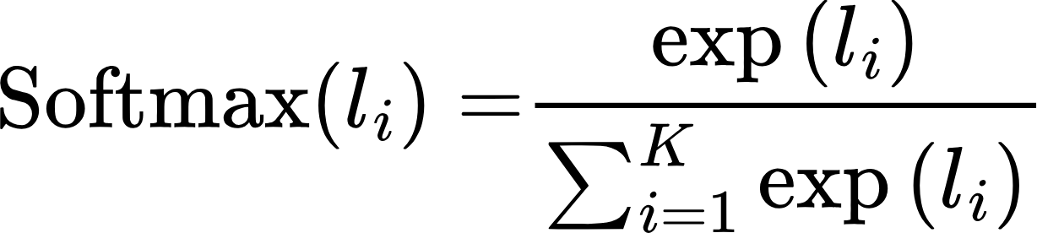
Cross Entropy Loss
First we need to convert network output into probabilities. This is done using a Softmax function. Say there are K classes
True probability distribution
convert logits into probabilities
p
l
(logits)
y
class probabilities
Softmax
Cross-entropy loss
Why does this expression make sense?
Usually p is a one-hot vector. It is 1 for the input’s true class, and 0 everywhere else.

Slide 23
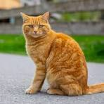
Cross Entropy Loss: Simple Example
Let’s say we have an image classification problem, with three classes--Cat, Dog, Horse. Our input data is image of a cat.
Predicted probability distribution y
True probability distribution p
Logits
Cat
0.24
0.09
0.66
1
0
0
-1
-2
0
Dog
Softmax
Cross-entropy loss
Horse
Usually p is a one-hot vector. It is 1 for the input’s true class, and 0 everywhere else.

Slide 24
Cross Entropy Loss
Let’s consider a binary classification example. Here K = 2
Let’s say p_1 = 1. If the network gets it right, y_1 is close to 1, and x-entropy loss is low. Similarly if the network gets it wrong, y_1 is low, and x-entropy loss is high.
To use it within a Neural Network, we need to calculate its derivative!

Slide 25
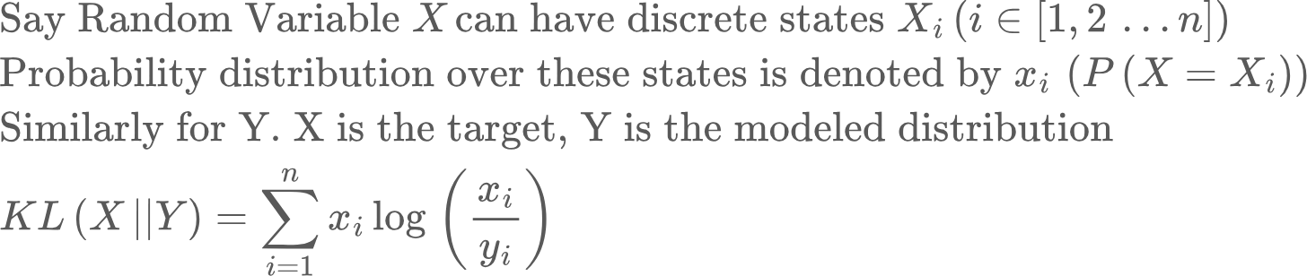
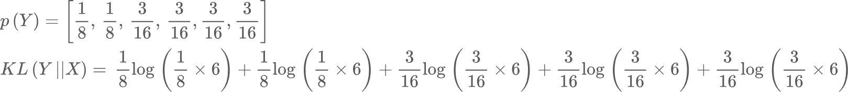
How do we compare two probability distributions?
Say we have two dice. One is a balanced dice (X), so the probability of rolling numbers 1-6 is ⅙. The second (Y) is unbalanced, with the following distribution
=0.016.
Note: KL(X||Y) = 0.017! KL(X||Y) doesn’t equal KL(Y||X)! I.e., KL distance isn’t symmetric!

Slide 26
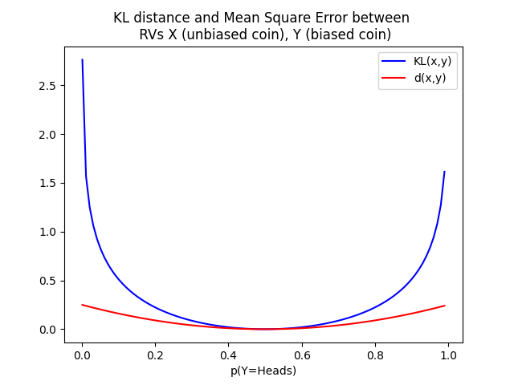
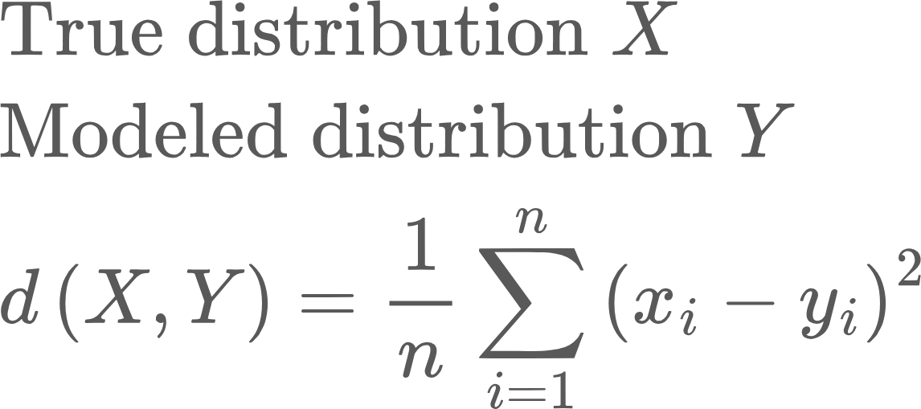
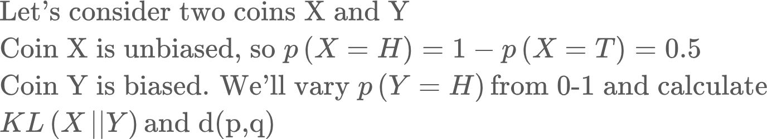
How do we compare two probability distributions?
Why not just use Mean Square Error?
Notice that KL distance penalizes large deviations between p(X) and p(Y) much more severely!
Also, when p(Y) assigns a 0 probability to an outcome that p(X) assigns a non-zero probability, KL distance blows up, while MSE doesn’t

Slide 27
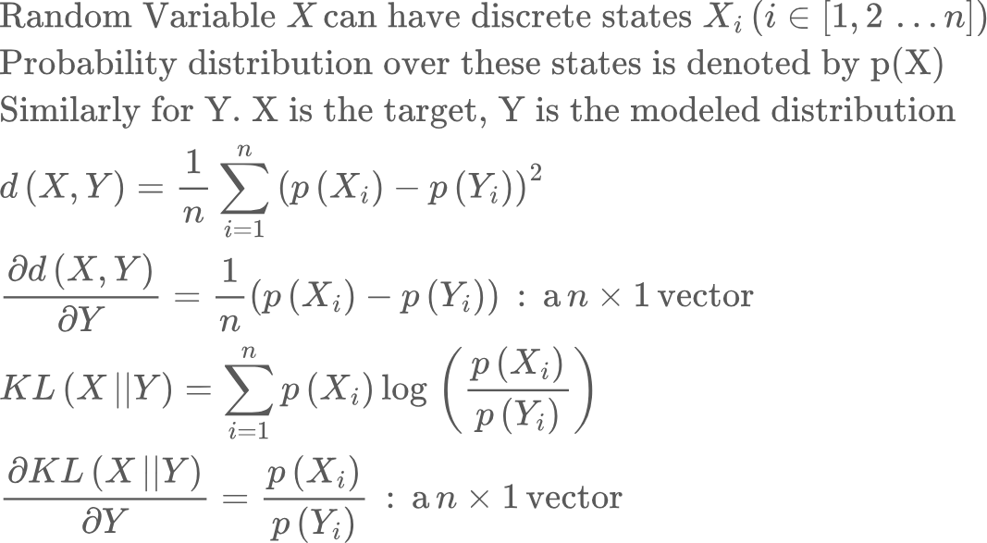
How do we compare two probability distributions?
Why not just use Mean Square Error?
Let’s consider the gradient wrt Y
The gradient of the KL distance is much larger when p(X) and p(Y) differ a lot. This results in faster convergence. More on this later..

Slide 28
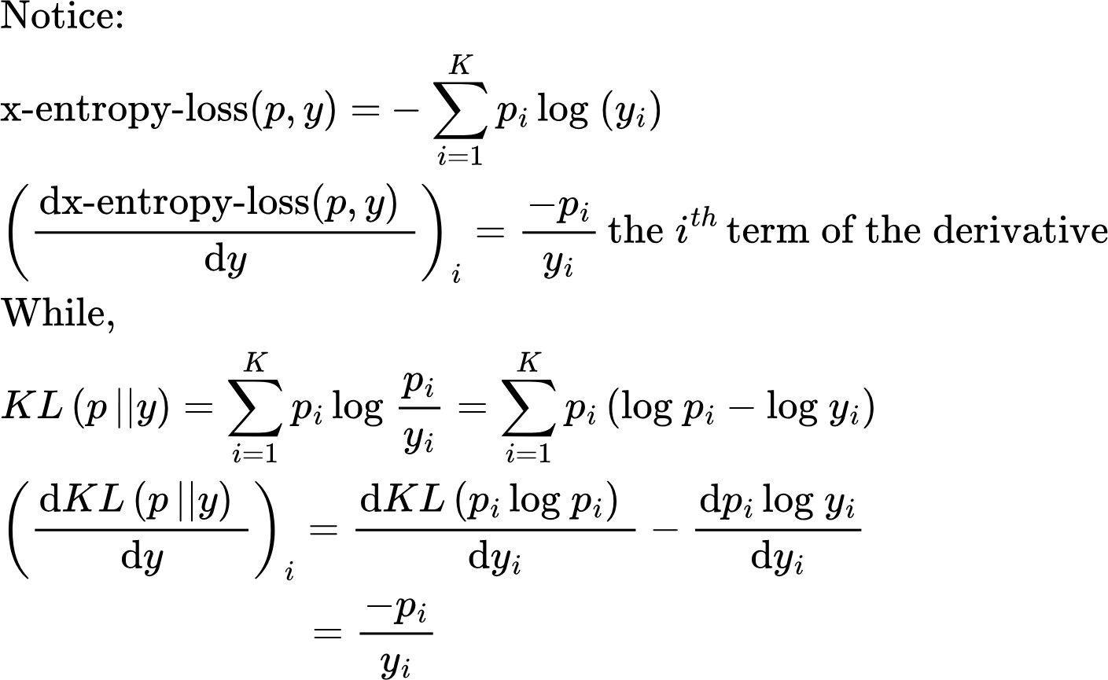
But cross-entropy loss isn’t the same as KL Distance!
So the first term in the KL distance is a constant, because it only depends on the true distribution.. And hence can be ignored.

Slide 29
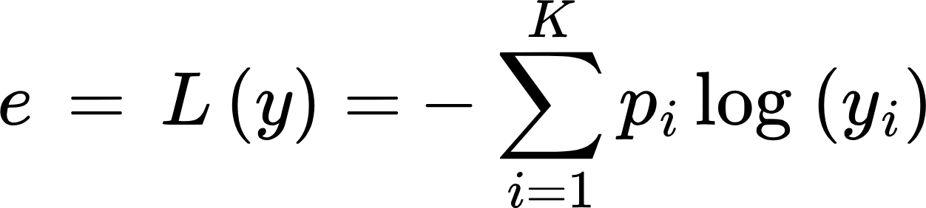
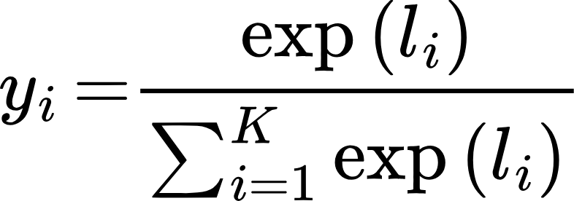
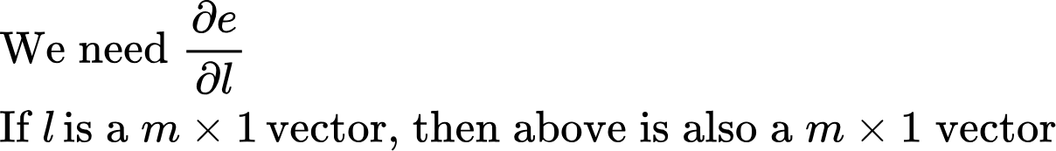
Cross Entropy Loss: Derivative
Continuing with the two class example...
Let’s now derive the partial of e against partial of l using basic math

Slide 30
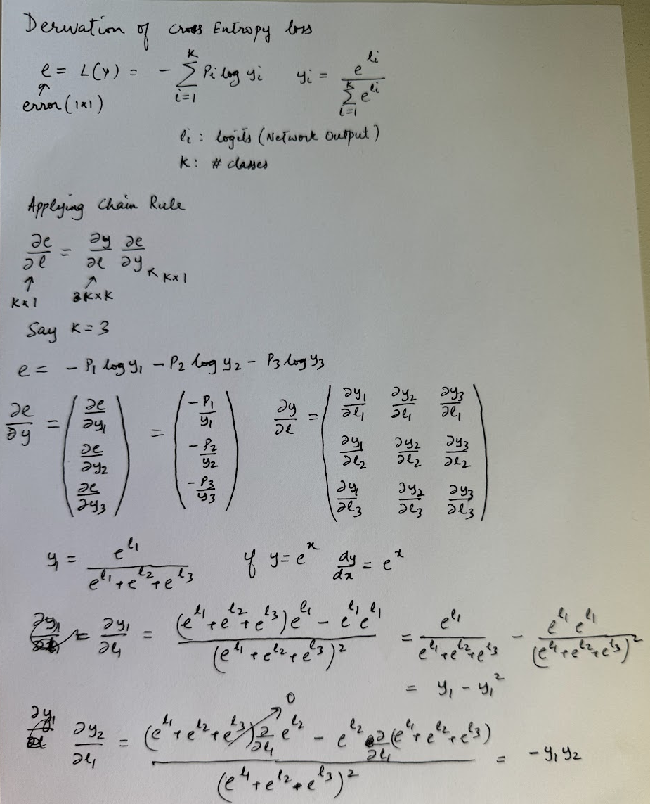
Cross Entropy Loss: Derivative

Slide 31
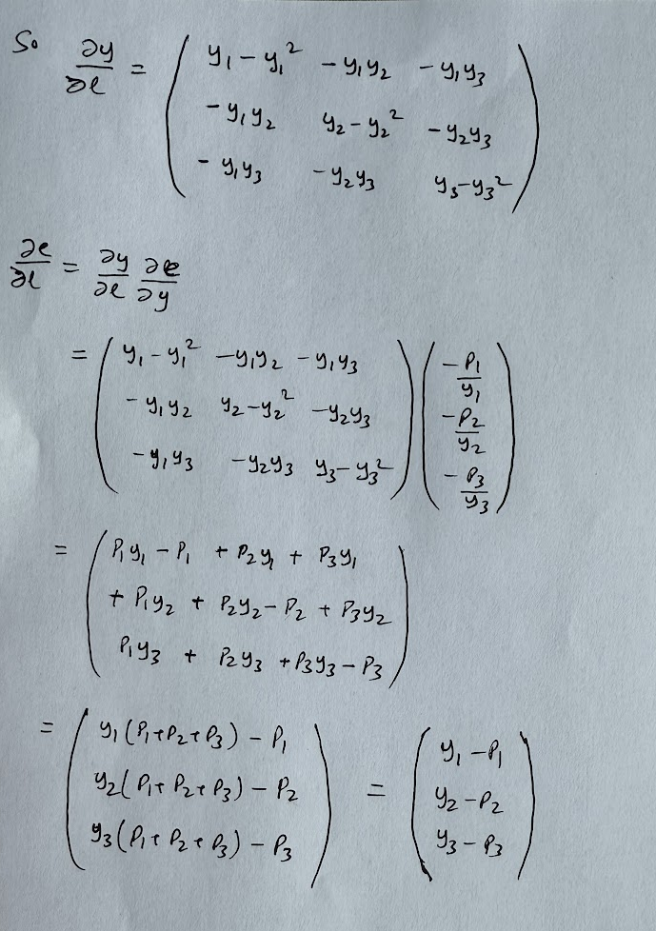
Cross Entropy Loss: Derivative

Slide 32
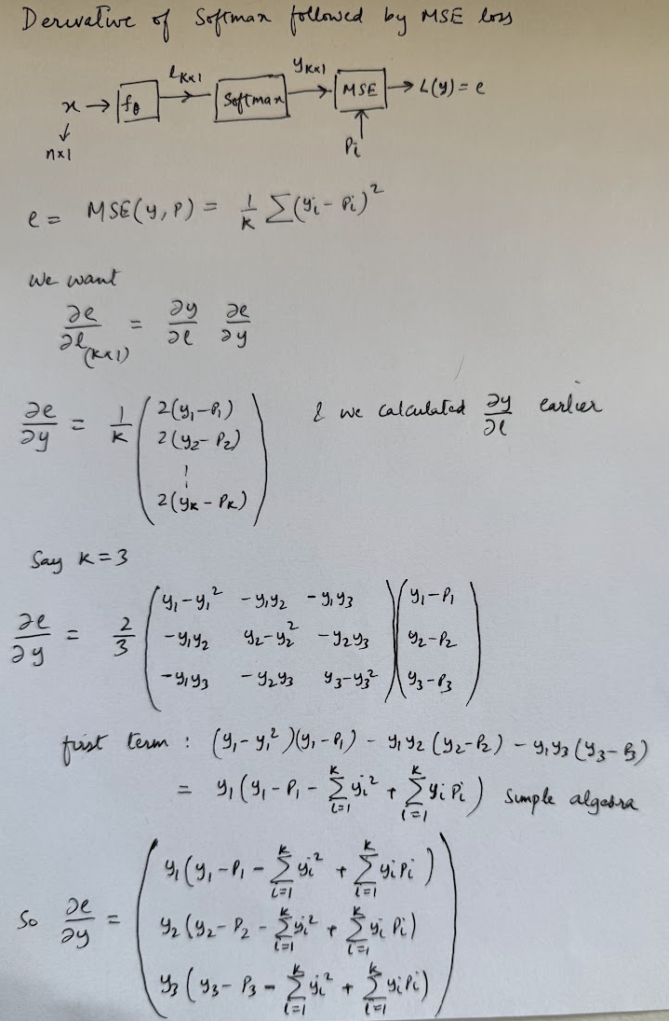
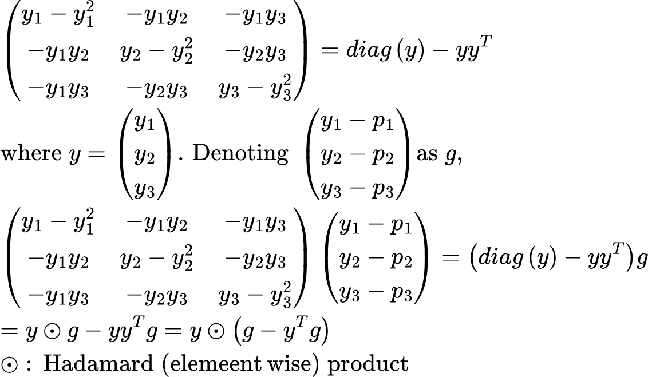
Derivative of Softmax followed by MSE
Notice that multiplicative factor of y.. This results in a small gradient when model assigns a small probability to the correct class, slowing down convergence!
Ignoring the factor of 2/3

Slide 33
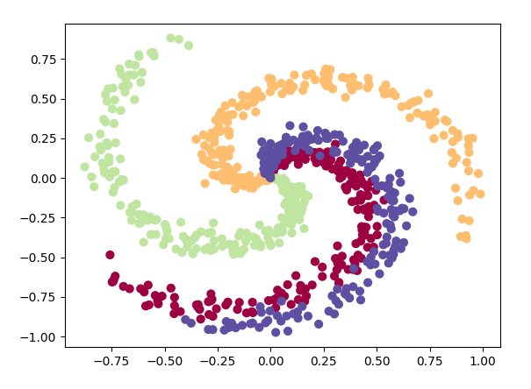
Example 2: Classifying points on a Spiral Dataset
In our first Neural Network example, we considered a regression problem, where the network was trained to predict the value of a sine function. Now we’ll consider a classification problem in 2D, where we have a set of points that lie on one of the arms of a spiral dataset. The task is to predict the label of the arm for each point.
Key differences from before:
The dimension of our input data is now 2, rather than 1
Network output is a vector rather than scalar
We’ll use cross-entropy loss rather than mean square error
Loss function and target metric (classification accuracy) are different!
Logging metrics in Tensorboard
Notes:
Why is this non-trivial?
Non-linear classification boundaries
A linear system can never solve this problem with a high degree of accuracy!

Slide 34
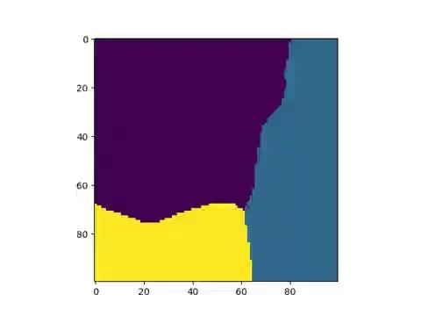
Classification boundaries of our neural network: Video

Slide 35
K-Fold Cross Validation
K-Fold Cross Validation:
Shuffle & Split the dataset into K folds (e.g., K=5).
Iteration: For each of the K folds:
Use K-1 folds for training.
Use the remaining 1 fold for validation (testing).
Repeat until every fold has served as the validation set exactly once.
Aggregate results by averaging the performance metrics (accuracy, F1, RMSE, etc.).
Train
Validate
Test
Naive training loop:
For every epoch:
For all training data:
Sample data and run training loop on training data
Evaluate performance on validation data
End Training
Evaluate performance on trained model on held out test data
But what if validation subset contains important data we want training to see?
Example:
Dataset → split into folds: [F1, F2, F3]
Run 1: Train = [F2+F3], Test = [F1]
Run 2: Train = [F1+F3], Test = [F2]
Run 3: Train = [F1+F2], Test = [F3]
Final performance = average of all 5 test results.
Generally not used during large Neural Network training..

Slide 36
Homework
Derive the backpropagation equation for x-entropy loss yourself, referring to the notes as needed
Why can’t we use the logits directly in x-entropy loss? Why do we take the exponential of each logit? Hint: Can probabilities be negative? What about logits?
Run the spiral data classification code (class3/simple_nn2.py) with default values.. You can turn on the draw_movie_frame feature to capture the classification boundaries as the optimization proceeds and the network learns.
Run the spiral data classification code without the ReLU non-linearities.. What do you observe?
Run the spiral data classification code for different hyperparameter values
Optimizer [simple, adam]
Number of hidden layers [2,3]
Learning rate schedule [constant, linear]
Different values of initial learning rate [0.01 - 0.1 in steps of .05]
For each “experiment”, log the loss progression and final metrics (loss, accuracy on test data) to Tensorflow and MLFlow

Slide 37
Accuracy can be misleading, specially when dataset is unbalanced
Declare H0
Declare H1
Is H0
Recall is the fraction of events where we correctly declared h0, out of all instances that are h0
Is H1
precision is the fraction of events where we correctly declared h0, out of all instances where we declared h0

